Slide 1
Computer Engineering 12 Class 14
Instructor: Yuhong Liu
Office: Bannan 324 F
Email: yhliu@scu.edu
Tel: 408-551-3513

Slide 2
Preorder Traversal
void visit(n) {
if (n is empty)
return;
print n;
for each child ch of n do
visit(ch);
}
A
a
B
D
a
C
a
a
E
F
a
a
G
a
The printing sequence is:
A, B, E, C, D, F, G
This type of traversal is called a preorder traversal (because the root comes before its children).
Also called a top-down traversal.

Slide 3
Using Recursion to Traverse a Tree
If we have “top down” then there’s also ...?

Slide 4
Using Recursion to Traverse a Tree
void postorder(n) {
if (n is not empty) {
for each child ch of n do
postorder(ch);
print n;
}
}
A
a
B
D
a
C
a
a
E
F
a
a
G
a
This type of traversal is called a postorder traversal (because the root comes after its children).
Also called a bottom-up traversal.
What is the printing sequence?

Slide 5
Using Recursion to Traverse a Tree
Understand how pre-order and post-order result in the parent being before or after its descendants respectively.

Slide 6
Count Nodes
In what order should you count your nodes? ...
Doesn’t matter
Let’s count all the nodes in a tree
int count(n) {
if (n is empty) return 0;
int cnt = 1; //count yourself
for each child c of n do
cnt = cnt + count(c);
return cnt;
}

Slide 7
Tree Height
How to count the height of a tree recursively?
add 1 to the height of the maximum of your children
Recursively, the height can be defined as follows:
height(n) =
0 , if n is empty
1 + max(height(ci)) , otherwise

Slide 8
Destroy a Tree
Should you destroy your tree in preorder or postorder ?
Answer: postorder!
Why?
Kill all your children before kill yourself

Slide 9
Summary
What is preorder? What is postorder?
Should we use preorder or postorder to do the following tasks?
Print a tree
Count the tree node
Search a tree
Destroy a tree
What is the print sequence for the tree below if we use preorder? How about postorder?
A
a
B
D
a
a
E
C
a
F
a
a
G
a
H
I
a
a
J
a

Slide 10
Binary Trees
In a general tree, each node can have an arbitrary number of children.
In a binary tree, each node has at most 2 children. We refer to them by name:
left child
right child

Slide 11
Binary Trees
Which of the following trees are binary trees?
A
a
A
A
a
a
B
D
a
C
a
B
a
a
D
B
D
a
a
a
E
F
a
a
G
a
E
a
F
E
a
a
F
a
G
a
G
a
A
A
a
a
H
B
a
B
D
a
a
a
E
a
E
a
F
a
G
a
G
a

Slide 12
Binary Trees
Implementation:
struct node {
int data;
struct node *left;
struct node *right;
};
typedef struct node NODE;

Slide 13
Binary Trees - Traversal
How to traverse a binary tree? The same as traversing a tree, except that we have only two children for binary trees (no need for a loop).
Write the code to recursively visit all the nodes in a binary tree. Given the function as
void printTree(NODE *n)

Slide 14
Binary Trees - Traversal
void printTree(NODE *n) {
if (n == NULL)
return;
printTree(n->left);
printTree(n->right);
printf(“%d\n”,n->data);
// “free” replaces printf if you were destroying the tree
}
Is this preorder or postorder?
What is the preorder way to traverse a binary tree?

Slide 15
Binary Trees - Height
How to count the height of a general tree?
add 1 to the height of the maximum of your children
How to count the height of a binary tree recursively?
add 1 to the height of the maximum of your left child and right child
int height(NODE *np) {}
A
a
B
a
D
a
E
a
F
a
G
a
H
a

Slide 16
Binary Trees - Height
int height(NODE *np) {
if (np == NULL)
return 0;
return(1 + max(height(np->left), height(np->right)));
}
OR
int height(NODE *np) {
if (np == NULL)
return 0;
lh = height(np->left);
rh = height(np->right);
return(1 + (lh>rh ? lh : rh));
}
Your own function

Slide 17
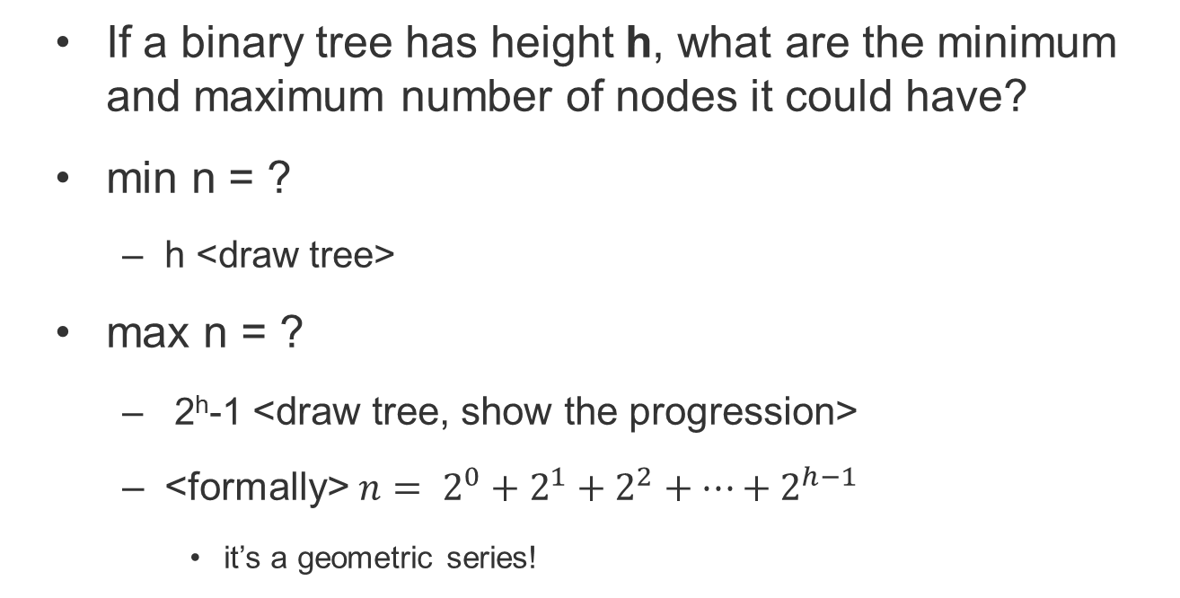
Binary Trees - Height
If a binary tree has height h, what are the minimum and maximum number of nodes it could have?
min n = ?
h <draw tree>
max n = ?
2^{h}-1 <draw tree, show the progression>
<formally> $n= 2^{0}+2^{1}+2^{2}+…+2^{h−1}$
it’s a geometric series!

Slide 18
Binary Trees - Height
If a binary tree has n nodes then what are its minimum and maximum heights?
max h = n <draw tree>
min h = floor(log2 (n)) + 1

Slide 19
Balanced Binary Tree
Balance factor for a binary tree
The difference in height between its left and right subtrees.
Balance factor = (h_left – h_right)
Examples: what are the balance factors for tree A?
Balanced binary tree:
the height of its subtrees differs by no more than one, and its subtrees are also balanced.
A
a
A
A
a
a
B
D
a
a
B
D
B
D
a
a
a
a
G
a
E
E
a
a
F
a
G
a
E
a
F
a
F
a

Slide 20
Binary Trees - Complete Tree
Complete tree
A complete tree has the maximum number of entries for its height.
Note that, the maximum number is reached when the last level is full.
Whether the following trees are complete trees?
A
A
a
a
A
A
a
a
B
C
a
a
B
D
B
D
a
a
a
a
E
a
F
a
G
H
E
F
a
a
a
a

Slide 21
So far, we don’t care the value of the tree nodes. We only care the tree structure.
From now on, we start to care the values of the tree nodes.

Slide 22
BST - Definition
A binary search tree is a binary tree that has the search order property.
For each node in the tree, all values to the left of the node are less than its value and all values to the right of the node are greater than its value.
Each subtree is itself a binary search tree.
K
All < K
All > K

Slide 23
BST - Definition
We can also define a BST recursively. A BST is either:
empty, OR
a node with data, and two sub-trees such that all values in the left subtree are less than the root, and all values in the right subtree are larger than the root
In other words, both subtrees are themselves BSTs
“BSTs all the way down”

Slide 24
BST - Definition
Which of these are BSTs?
A BST is not necessary to be either a balanced tree or a complete tree!
17
17
17
17
6
6
19
19
6
3
17
17
17
6
19
19
6
19
3
14
22
3
20
Notes:
1, 2, 4, 5,6

